Slide 1
Systems operating
Team Yellow

Slide 2
introduction
The operating system is the software that coordinates and manages all the services and applications used by the user in a computer, that is why it is the most important and fundamental.

Slide 3
Operating system
The operating system is the software that coordinates and manages all the services
and applications used by the user in a computer, that is why it is the most important
and fundamental. These are programs that enable and regulate the most basic
aspects of the system. The most commonly used operating systems are Windows,
Linux, OS/2 and DOS.

Slide 4
survey
1. Select the type of Operating System you consider most common:
2. What is the most important feature of an OS?
3. Which sector is most related to OS usage?
SO multitasking
SO in real time
SO network
SO
Security
Usability
Design
Portability
Medicine
Accounting
Policy
Computer Science

Slide 5
4. Which of the following OS does not handle a graphical interface?
5. Which of the following is an OS function?
Windows 2000
Unix
Windows XP
Mac OS
All of the above
Be an interface between the computer and the user
Manage computer resources
Organize the information stored in the computer

Slide 6
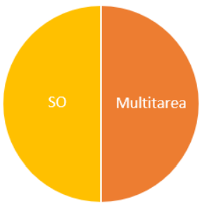
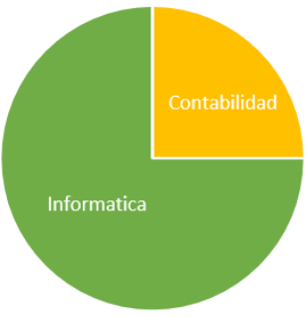
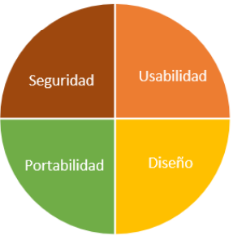
Interpret the results
1
2
3

Slide 7
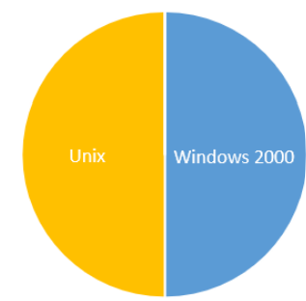
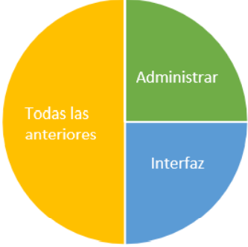
4
5

Slide 8
Conclusion
For consumers it is importan to have an operating system that is multitasking, that can be secure, usable, portable and that has a Good desing, since they use it in áreas where they deal with a Little bit of everything, such as administration, accounting. So if the operating system meets all these points and also for very few resources, consumers Will opt forit.

Slide 9
Thanks
Landín Jarquín Victoria Daniela.
Jose Galloso Víctor Ángel.
Molina Vaquier Maritzel.
Muñoz Rodríguez Jessica.
Rivero Blanco Martha Guadalupe.

